Slide 1
At Home Frequency Response Analysis
SDMay21-49 Members: Samuel Ferguson, George Youngwirth, Kathryn Blesi, Rohan Gijare, Tabitha Kiiru, and David Gorzney.
Client & Advisor: Gary Tuttle
Notes:
Katie

Slide 2
Project Statement
Due to the COVID19 pandemic, students are left without lab equipment while taking electronics courses. Students had the option of using analog exploration boards, but, these boards went out of production and cost $399 each.
One part of electronics courses such as EE230 is frequency response analysis of filter circuits.
The goal of our project is to create an affordable and simple frequency response analysis device that students can use anywhere.
Notes:
Katie

Slide 3
Requirements
Technical:
Sweepable AC source
Frequency ranging from 10 Hz to 1 MHz
Chip to measure RMS value
Microcontroller
Automate sweep & measurement
Memory module
Storing results
Interface
Control and review measurements
Non-Functional:
Portable
Easy to use
Cost less than $25
Notes:
Katie

Slide 4
New Skills/Knowledge Gained
Python Programming
Used to design the user interface
PCB design using KiCAD
Arduino Programming (C++)
MCU Programming
Used to set up the function generator IC
Application Specific Integrated Circuit (ASIC) unit testing
Used for testing both the function generator and the RMS to DC convertor
Notes:
George

Slide 5
Development Process
Waterfall method
1 task at a time
Kept us organized
Reviewed project and met with client
Created conceptual design
Led to detailed design
Designed Function Generator Module
Created Arduino Code (C++)
Performed Unit Tests
Designed RMS to DC Converter Module
Performed Unit Tests
Created Frequency Response Analyzer Application (Python)
Performed Unit Tests
Integrated Modules
Performed System Testing & Verification
Notes:
David

Slide 6
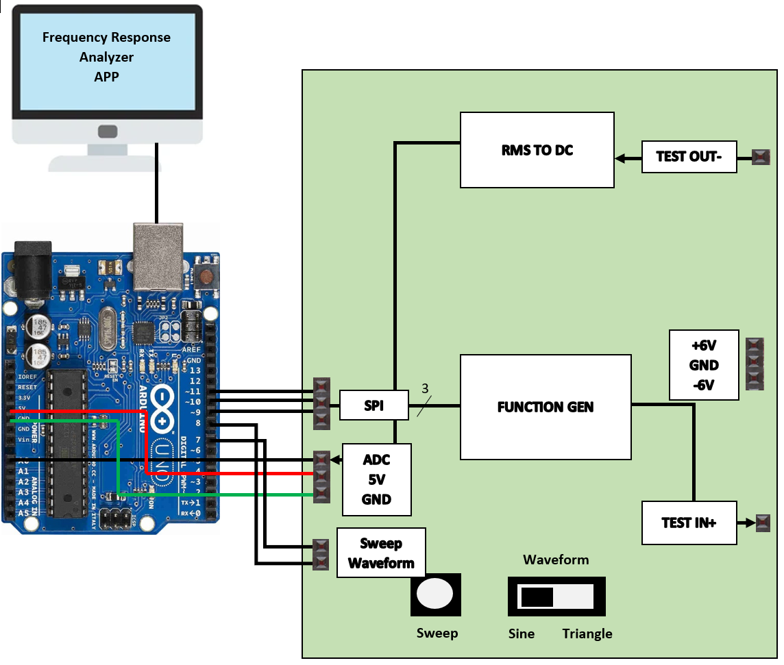
Design Conception
Notes:
George

Slide 7
Design Evolution
Software developed
LCD screen removed
Software plots the frequency responses on logarithmic plot to the PC
Frequency generation knob removed
Device does a sweep through the entire frequency range
No SD port
Results were automatically saved to a csv file through the usb port
Completed product
The product is no longer sold as a bag of parts.
A PCB was designed so that there can be no soldering errors by the user
Price
The two ICs cost $25 themselves
Added requirement for the user to have an arduino already that they can plug into
Power supply
The device is to be powered with 12V battery power
This was done to eliminate grounding issues with PCs so that our device does not fry the PC
Notes:
Tabitha

Slide 8
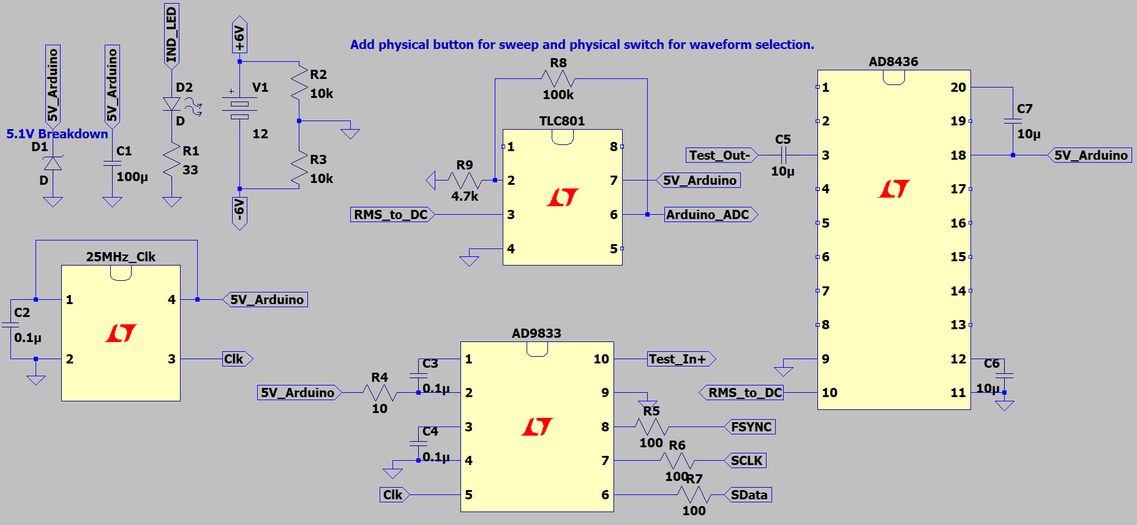
Design Schematic & PCB
Notes:
Tabitha

Slide 9
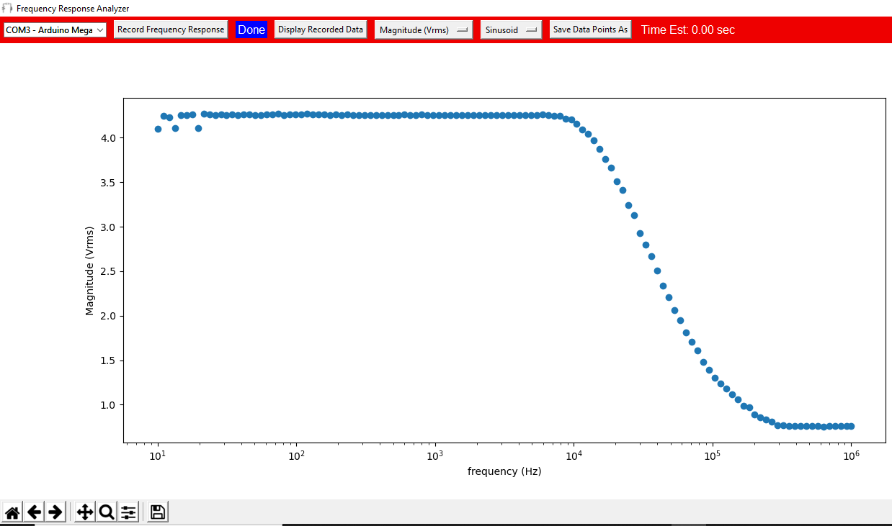
Software Interface
RC Low Pass Filter:
1/(2pi*akohm*10nf) = 15.9KHz
Notes:
Sam Ferguson

Slide 10
Code
Notes:
Sam Ferguson

Slide 11
Testing
Function Generator Module -
Sweep from 10Hz to 1MHz.
Output a significant voltage difference Vpk-pk.
Select between sinusoid and triangle waveforms.
RMS to DC Converter Module -
Accurately converter Vrms values to DC values.
Software -
Robustness of user interface.
Error/Exception Handling and Optimization
System -
Tested using passive and active filter configurations.
Display correct filter frequency response.
Notes:
David

Slide 12
Implementation
Design function generator module using AD9833 IC
Learned SPI, bit placement, and data conversions for the IC
Programed via Arduino
Prototype Python application
Take a CSV of data and display on plot
Arduino to serialize ADC voltages and send to PC
Design RMS to DC converter module
Sample test circuit from AD8436 datasheet
Little to no offset with coupling capacitor
Finalizing software
Magnitude sampling added; Python freq. range matched to freq. sweep of function generator
Changed plot from linear to logarithmic
Added optional batter supply
PCB using KiCAD
Notes:
George

Slide 13
Operation
9. Move the waveform selection switch to the corresponding position for sinusoid or triangle waveforms.
10. Click “Record Frequency Response” button on the Frequency Response Analyzer App.
You have 5 seconds to click the Sweep Button on the Board or Circuit.
The indicator label should say “Reading” if data is being properly read by the application from the Arduino.
A time estimation should appear on the rightmost label in the application.
The indicator label will say “Done” once the data is done being recorded.
11. Press the “Display Recorded Data” button once the samples have been recorded.
This will display a graph corresponding to the data points taken.
You can select the format by selecting “Magnitude (Vrms)” or “Magnitude (dB)” and also selecting “Sinusoid” or “Triangle”.
12. You can save the data points into a csv by pressing the “Save Data Points As” button and selecting a destination.
Run application by double clicking the shortcut or on the “Frequency Response Analyzer.exe” file.
Plug the Arduino into your PC.
Click the down arrow on the “Comport” dropdown box.
Select the Comport that corresponds to your Arduino.
Connect the ground of your circuit to the GND pin on the schematic or board.
Connect the Test In+ probe to the input of your filter circuit.
Connect the Test Out- to the output of your filter circuit.
Power the Vdd and Vss terminals of your active filter’s op-amps using the +6V and -6V terminals.
Notes:
Rohan

Slide 14
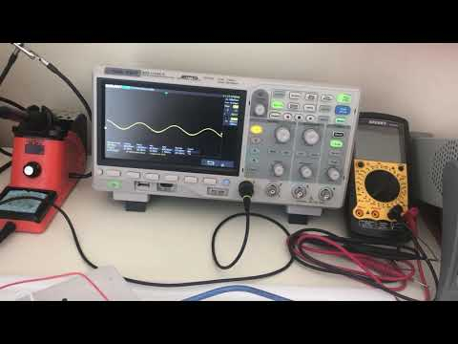
Demo

Slide 15
Q & A

